Slide 1
CSE 440
Artificial Intelligence
Informed Search
Dr. Mohammad Mahmudul Alam
Department of Electrical & Computer Engineering (ECE)
North South University (NSU)

Slide 2
Last Time
Search: process of constructing sequences of actions that achieve a goal given a problem.
The studied methods assume that the environment is observable, deterministic, static and completely known.
A solution is a path from the initial state to a goal state.
Search algorithms are judged based on completeness, optimality, time complexity and space complexity.
Several uninformed search strategies: BFS, UCS, DFS, DLS, IDS, BDS
All uninformed searches have an exponential time complexity.

Slide 3
Informed Search
An informed search strategy - one that uses problem specific knowledge … can find solutions more efficiently than an uninformed strategy.
The hints come in the form of a heuristic function, denoted h(n)

Slide 4
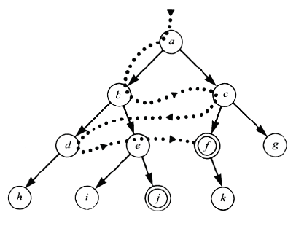
Problem with Uninformed Search
Without incorporating knowledge into searching, one can have no bias (i.e. a preference) on the search space.
Without a bias, one is forced to look everywhere to find the answer. Hence, the complexity of uninformed search is intractable.
Search everywhere!!

Slide 5
Problem Specific Knowledge to Aid Search
With knowledge, one can search the state space as if he was given “hints” when exploring a maze.
  Heuristic information in search = Hints
Leads to dramatic speed up in efficiency.
A
B
C
D
E
Search only in this subtree!!!
F
G
H
I
J
K
L
M
N
O

Slide 6
Heuristic Functions
In any search problem where there are at most b choices at each node and a depth of d at the goal node, a naive search algorithm would have to, in the worst case, search around O(b^{d}) nodes before finding a solution (Exponential Time Complexity).
Heuristics improve the efficiency of search algorithms by reducing the effective branching factor from b to (ideally) a low constant b* such that
1 =< b* << b

Slide 7
Definition: Heuristic
Heuristic is a rule of thumb, simplification, or educated guess
A commonsense rule (or set of rules) intended to increase the probability of solving some problem
Does not guarantee feasible solutions; often with no theoretical guarantee
Playing chess: try to take the opponent’s queen
Getting someplace: head in that compass direction when possible

Slide 8
Heuristic Functions
A heuristic function f(n) gives an estimation on the “cost” of getting from node n (state) to the goal state – so that the node with the least cost among all possible choices can be selected for expansion first.
Three approaches for defining f(n):
f measures the value of the current state (its “goodness”)
f measures the estimated cost of getting to the goal from the current state:
f(n) = h(n) where h(n) = an estimate of the cost to get from n to a goal
f measures the estimated cost of getting to the goal state from the current state and the cost of the existing path to it. Often, in this case, we decompose f:
f(n) = g(n) + h(n) where g(n) = the cost to get to n (from initial state)

Slide 9
Approach 1: F Measures the Value of the Current State
Usually, the case when solving optimization problems
  Finding a state such that the value of the metric f is optimized
Often, in these cases, f could be a weighted sum of a set of component values:
  N-Queens
    Example: the number of queens under attack …
  Data mining
    Example: the “predictive-ness” (a.k.a. accuracy) of a rule discovered

Slide 10
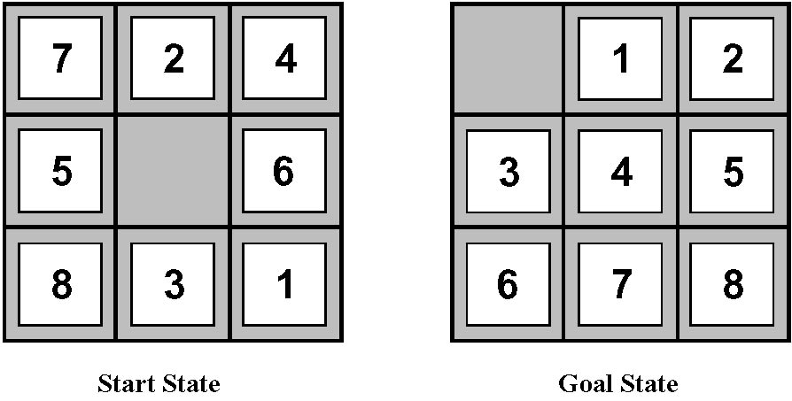
Approach 2: F Measures the Cost of the Goal
A state X would be better than a state Y if the estimated cost of getting from X to the goal is lower than that of Y – because X would be closer to the goal than Y
8–Puzzle
h1: The number of misplaced tiles.
h2: The sum of the distances of the tiles from their goal positions. (Manhattan distance)

Slide 11
Approach 3: F Measures the Total Cost of the Solution Path
A heuristic function f(n) = g(n) + h(n) is admissible if h(n) never overestimates the cost to reach the goal.
Admissible heuristics are “optimistic”: “the cost is not that much …”
However, g(n) is the exact cost to reach node n from the initial state.
Therefore, f(n) never over-estimate the true cost to reach the goal state through node n.
Theorem: A search is optimal if h(n) is admissible.
  i.e., The search using h(n) returns an optimal solution.
Given h₂(n) > h₁(n) for all n, it’s always more efficient to use h₂(n).
  h₂ is more realistic than h₁ (more informed), though both are optimistic.

Slide 12
Informed Search Strategies
Greedy Best First Search
“Always chooses the successor node with the best f value” where f(n) = h(n)
We choose the one that is nearest to the final state among all possible choices
A* Search
Best first search using an “admissible” heuristic function f that takes into account the current cost g(n)
Always returns the optimal solution path

Slide 13
Greedy Best First Search
Start
State | Heuristic: h(n)
A | 366
B | 374
C | 329
D | 244
E | 253
F | 178
G | 193
H | 98
I | 0
A
75
118
140
B
C
111
E
D
80
99
G
F
97
H
211
101
I
Goal
f(n) = h (n) = straight-line distance heuristic

Slide 14
Greedy Best First Search
Start
State | Heuristic: h(n)
A | 366
B | 374
C | 329
D | 244
E | 253
F | 178
G | 193
H | 98
I | 0
A
75
118
140
B
C
111
E
D
80
99
G
F
97
H
211
101
I
Goal
f(n) = h (n) = straight-line distance heuristic

Slide 15
Greedy Best First Search
Start
State | Heuristic: h(n)
A | 366
B | 374
C | 329
D | 244
E | 253
F | 178
G | 193
H | 98
I | 0
A
75
118
140
B
C
111
E
D
80
99
G
F
97
H
211
101
I
Goal
f(n) = h (n) = straight-line distance heuristic

Slide 16
Greedy Best First Search
Start
State | Heuristic: h(n)
A | 366
B | 374
C | 329
D | 244
E | 253
F | 178
G | 193
H | 98
I | 0
A
75
118
140
B
C
111
E
D
80
99
G
F
97
H
211
101
I
Goal
f(n) = h (n) = straight-line distance heuristic

Slide 17
Greedy Best First Search
Start
State | Heuristic: h(n)
A | 366
B | 374
C | 329
D | 244
E | 253
F | 178
G | 193
H | 98
I | 0
A
75
118
140
B
C
111
E
D
80
99
G
F
97
H
211
101
I
Goal
f(n) = h (n) = straight-line distance heuristic

Slide 18
Greedy Best First Search
Start
State | Heuristic: h(n)
A | 366
B | 374
C | 329
D | 244
E | 253
F | 178
G | 193
H | 98
I | 0
A
75
118
140
B
C
111
E
D
80
99
G
F
97
H
211
101
I
Goal
f(n) = h (n) = straight-line distance heuristic

Slide 19
Greedy Best First Search
Start
State | Heuristic: h(n)
A | 366
B | 374
C | 329
D | 244
E | 253
F | 178
G | 193
H | 98
I | 0
A
75
118
140
B
C
111
E
D
80
99
G
F
97
H
211
101
I
Goal
f(n) = h (n) = straight-line distance heuristic

Slide 20
Greedy Best First Search
Start
State | Heuristic: h(n)
A | 366
B | 374
C | 329
D | 244
E | 253
F | 178
G | 193
H | 98
I | 0
A
75
118
140
B
C
111
E
D
80
99
G
F
97
H
211
101
I
Goal
f(n) = h (n) = straight-line distance heuristic

Slide 21
Greedy Best First Search
Start
State | Heuristic: h(n)
A | 366
B | 374
C | 329
D | 244
E | 253
F | 178
G | 193
H | 98
I | 0
A
75
118
140
B
C
111
E
D
80
99
G
F
97
H
211
101
I
Goal
f(n) = h (n) = straight-line distance heuristic

Slide 22
Greedy Best First Search
Start
State | Heuristic: h(n)
A | 366
B | 374
C | 329
D | 244
E | 253
F | 178
G | 193
H | 98
I | 0
A
75
118
140
B
C
111
E
D
80
99
G
F
97
H
211
101
I
Goal
f(n) = h (n) = straight-line distance heuristic

Slide 23
Greedy Best First Search
State | h(n)
A | 366
B | 374
C | 329
D | 244
E | 253
F | 178
G | 193
H | 98
I | 0
Start
A

Slide 24
Greedy Best First Search
State | h(n)
A | 366
B | 374
C | 329
D | 244
E | 253
F | 178
G | 193
H | 98
I | 0
Start
A
75
118
[329]
140
[374]
B
C
[253]
E
Notes:
From A, straight distance is 366
Among C, E, B -> E is nearer, so expand E

Slide 25
Greedy Best First Search
State | h(n)
A | 366
B | 374
C | 329
D | 244
E | 253
F | 178
G | 193
H | 98
I | 0
Start
A
75
118
[329]
140
[374]
B
C
[253]
E
80
99
[193]
[178]
G
F
[366]
A

Slide 26
Greedy Best First Search
State | h(n)
A | 366
B | 374
C | 329
D | 244
E | 253
F | 178
G | 193
H | 98
I | 0
Start
A
75
118
[329]
140
[374]
B
C
[253]
E
80
99
[193]
[178]
G
F
[366]
A
211
[253]
I
[0]
E
Goal

Slide 27
Greedy Best First Search
State | h(n)
A | 366
B | 374
C | 329
D | 244
E | 253
F | 178
G | 193
H | 98
I | 0
Start
A
75
118
[329]
140
[374]
B
C
[253]
E
80
99
[193]
[178]
G
F
[366]
A
211
[253]
I
[0]
E
dist(A-E-F-I) = 140 + 99 + 211 = 450
Goal

Slide 28
Greedy Best First Search: Optimal? No
Start
State | Heuristic: h(n)
A | 366
B | 374
C | 329
D | 244
E | 253
F | 178
G | 193
H | 98
I | 0
A
75
118
140
B
C
111
E
D
80
99
G
F
97
H
211
101
I
Goal
f(n) = h (n) = straight-line distance heuristic
dist(A-E-G-H-I) =140+80+97+101=418
Notes:
Not optimal

Slide 29
Greedy Best First Search: Optimal?
Start
State | Heuristic: h(n)
A | 366
B | 374
** C | 250
D | 244
E | 253
F | 178
G | 193
H | 98
I | 0
A
75
118
140
B
C
111
E
D
80
99
G
F
97
H
211
101
I
Goal
f(n) = h (n) = straight-line distance heuristic
Notes:
If for some reason, lets say straight distance from C is 250, then what happened?

Slide 30
Greedy Search
State | h(n)
A | 366
B | 374
C | 250
D | 244
E | 253
F | 178
G | 193
H | 98
I | 0
Start
A

Slide 31
Greedy Search
State | h(n)
A | 366
B | 374
C | 250
D | 244
E | 253
F | 178
G | 193
H | 98
I | 0
Start
A
75
118
[250]
140
[374]
B
C
[253]
E

Slide 32
Greedy Search
State | h(n)
A | 366
B | 374
C | 250
D | 244
E | 253
F | 178
G | 193
H | 98
I | 0
Start
A
75
118
[250]
140
[374]
B
C
[253]
E
111
[244]
D

Slide 33
Greedy Search: Tree Search
Greedy Search
State | h(n)
A | 366
B | 374
C | 250
D | 244
E | 253
F | 178
G | 193
H | 98
I | 0
Start
A
75
118
[250]
140
[374]
B
C
[253]
E
111
[244]
D
Infinite Branch !
[250]
C

Slide 34
Greedy Search
State | h(n)
A | 366
B | 374
C | 250
D | 244
E | 253
F | 178
G | 193
H | 98
I | 0
Start
A
75
118
[250]
140
[374]
B
C
[253]
E
111
[244]
D
Infinite Branch !
[250]
C
[244]
D

Slide 35
Greedy Search
State | h(n)
A | 366
B | 374
C | 250
D | 244
E | 253
F | 178
G | 193
H | 98
I | 0
Start
A
75
118
[250]
140
[374]
B
C
[253]
E
111
[244]
D
Infinite Branch !
[250]
C
[244]
D
Notes:
Even not complete

Slide 36
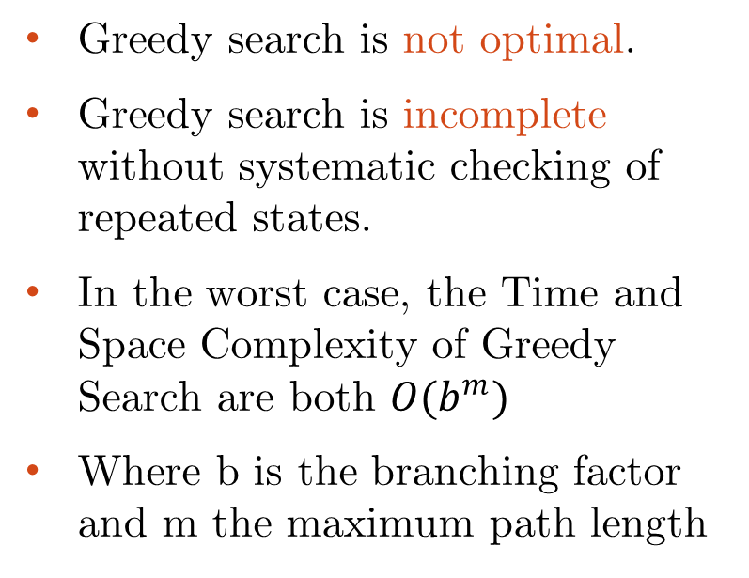
Greedy Search
Start
A
75
Greedy search is not optimal.
Greedy search is incomplete without systematic checking of repeated states.
In the worst case, the Time and Space Complexity of Greedy Search are both $O(b^{m})$
Where b is the branching factor and m the maximum path length
118
140
B
C
111
E
D
80
99
G
F
97
H
211
101
I
Goal

Slide 37
A* Search
The most common informed search algorithm is A* /A-star/ search, a best-first search that uses the evaluation function f(n) = g(n) + h(n)
g(n) is the path cost from the initial state to node n.
h(n) is the estimated cost of the shortest path from node n to goal state.
f(n) is the estimated cost of the best path that continues from node n to goal.

Slide 38
A* Search
Greedy Search minimizes a heuristic h(n) which is an estimated cost from a node n to the goal state.
However, although greedy search can considerably cut the search time (efficient), it is neither optimal nor complete.
Uniform Cost Search minimizes the cost g(n) from the initial state to node n
UCS is optimal and complete but not efficient.
New Strategy (A*): Combine Greedy Search and UCS to get an efficient algorithm which is complete and optimal.

Slide 39
A* Search
A* uses a heuristic function which combines g(n) and h(n), f(n) = g(n) + h(n)
g(n) is the exact cost to reach node n from the initial state. Cost so far up to node n.
h(n) is an estimation of the remaining cost to reach the goal.

Slide 40
A* Search
Start
g(n)
node
n
f(n) = g(n)+h(n)
h(n)
Goal

Slide 41
A* Search
Start
State | Heuristic: h(n)
A | 366
B | 374
C | 329
D | 244
E | 253
F | 178
G | 193
H | 98
I | 0
A
75
118
140
B
C
111
E
D
80
99
G
F
97
H
211
101
I
Goal
f(n) = g(n) + h(n)
g(n): is the exact cost to reach node n from the initial state.

Slide 42
A* Search
State | h(n)
A | 366
B | 374
C | 329
D | 244
E | 253
F | 178
G | 193
H | 98
I | 0
A
Start

Slide 43
A* Search
State | h(n)
A | 366
B | 374
C | 329
D | 244
E | 253
F | 178
G | 193
H | 98
I | 0
A
Start
118
75
140
E
[393]
B
[449]
[447]
C
C[447] = 118 + 329
E[393] = 140 + 253
B[449] = 75 + 374
Notes:
C[447] = 118 + 329
E[393] = 140 + 253
B[449] = 75 + 374

Slide 44
A* Search
State | h(n)
A | 366
B | 374
C | 329
D | 244
E | 253
F | 178
G | 193
H | 98
I | 0
A
Start
118
75
140
E
[393]
B
[449]
[447]
C
80
99
[413]
G
F
[417]

Slide 45
A* Search
State | h(n)
A | 366
B | 374
C | 329
D | 244
E | 253
F | 178
G | 193
H | 98
I | 0
A
Start
118
75
140
E
[393]
B
[449]
[447]
C
80
99
[413]
G
F
[417]
97
[415]
H

Slide 46
A* Search
State | h(n)
A | 366
B | 374
C | 329
D | 244
E | 253
F | 178
G | 193
H | 98
I | 0
A
Start
118
75
140
E
[393]
B
[449]
[447]
C
80
99
[413]
G
F
[417]
97
[415]
H
101
I
[418]
Goal

Slide 47
A* Search
State | h(n)
A | 366
B | 374
C | 329
D | 244
E | 253
F | 178
G | 193
H | 98
I | 0
A
Start
118
75
140
E
[393]
B
[449]
[447]
C
80
99
[413]
G
F
[417]
97
[415]
H
I
[450]
101
I
[418]
Goal

Slide 48
A* Search
State | h(n)
A | 366
B | 374
C | 329
D | 244
E | 253
F | 178
G | 193
H | 98
I | 0
A
Start
118
75
140
E
[393]
B
[449]
[447]
C
80
99
[413]
G
F
[417]
97
[415]
H
I
[450]
101
I
[418]
Goal

Slide 49
A* Search
State | h(n)
A | 366
B | 374
C | 329
D | 244
E | 253
F | 178
G | 193
H | 98
I | 0
A
Start
118
75
140
E
[393]
B
[449]
[447]
C
80
99
[413]
G
F
[417]
97
[415]
H
I
[450]
101
I
[418]
Goal

Slide 50
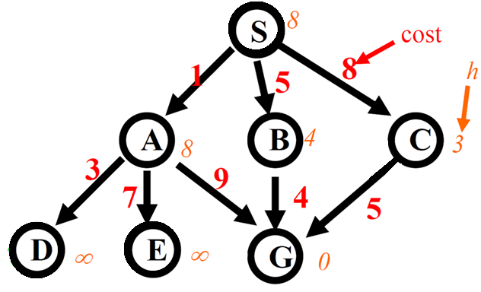
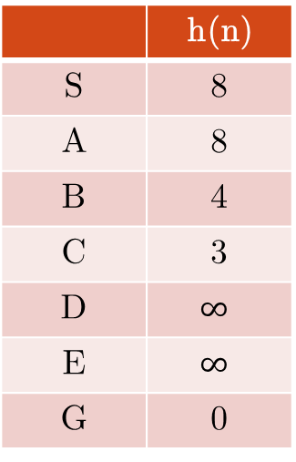
Exercise
 | h(n)
S | 8
A | 8
B | 4
C | 3
D | $$∞$$
E | $$∞$$
G | 0
Show the current node and the nodes in the frontier for both Greedy search (f(n) = h(n)) and A* (f(n) = g(n) + h(n)) algorithms.

Slide 51
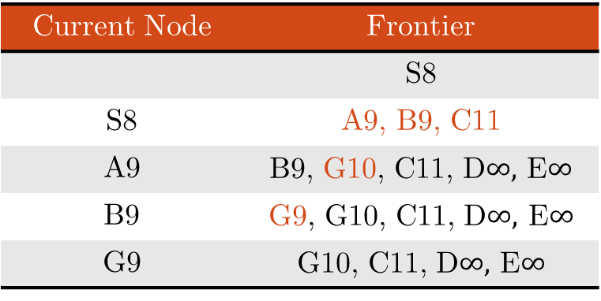

Exercise
Greedy search (f(n) = h(n))
Current Node | Frontier
 | S8
S8 | C3, B4, A8
C3 | G0, B4, A8
G0 | B4, A8
 | h(n)
S | 8
A | 8
B | 4
C | 3
D | $$∞$$
E | $$∞$$
G | 0
A* (f(n) = g(n) + h(n))
Current Node | Frontier
 | S8
S8 | A9, B9, C11
A9 | B9, G10, C11, D$∞,$ E$∞$
B9 | G9, G10, C11, D$∞,$ E$∞$
G9 | G10, C11, D$∞,$ E$∞$

Slide 52
Conditions for Optimality
Admissibility
  An admissible heuristic never overestimates the cost to reach the goal
  Straight-line distance h_{SLD} obviously is an admissible heuristic
A* is optimal if h is admissible or consistent
N
c(N,N’)
N’
h(N)
h(N’)
The admissible heuristic h is consistent (monotone restriction) if for every node N and every successor N’ of N:
h(N) ≤ c(N,N’) + h(N’)
(triangular inequality)
A consistent heuristic is admissible.

Slide 53
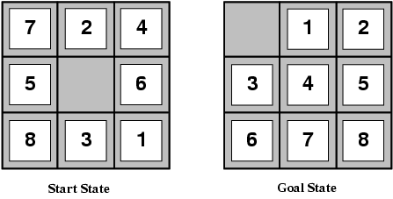
Effect of Heuristic Accuracy on Performance
E.g., for the 8-puzzle:
h₁(n) = number of misplaced tiles
h₂(n) = total Manhattan distance
(i.e., no. of squares from desired location of each tile)
h₁(S) = ?
h₂(S) = ?

Slide 54
Effect of Heuristic Accuracy on Performance
E.g., for the 8-puzzle:
h₁(n) = number of misplaced tiles
h₂(n) = total Manhattan distance
(i.e., no. of squares from desired location of each tile)
h₁(S) = ? 8
h₂(S) = ? 3+1+2+2+2+3+3+2 = 18

Slide 55
Dominance
If h₂(n) ≥ h₁(n) for all n (both admissible)
then h₂ dominates h₁
h₂ is better for search
Why?
Typical search costs (average number of nodes expanded):
d=12
A*(h₁) = 227 nodes
A*(h₂) = 73 nodes
d=24
A*(h₁) = 39,135 nodes
A*(h₂) = 1,641 nodes

Slide 56
When to Use Search Techniques
The search space is small, and
  There are no other available techniques, or
  It is not worth the effort to develop a more efficient technique
The search space is large, and
  There is no other available techniques, and
  There exist “good” heuristics
Even though heuristics improve the performance of informed search algorithms, they are still time consuming especially for large size instances.

Slide 57
Reading
Chapter 03 of the textbook
Pages 102 to 106, 115 to 117

